Slide 1
Loan approval Prediction

Slide 2
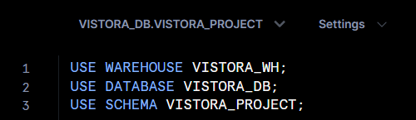
Step 1:
Create a SQL worksheet in Snowflake, and select the correct database and schema.

Slide 3
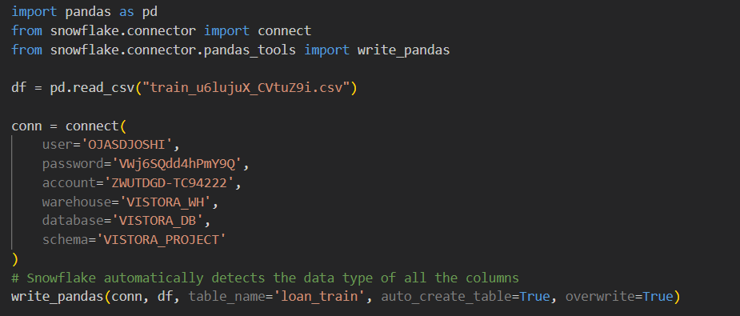
Step 2:
Create a python file. Connect to snowflake using snowflake-connector-python.
Upload the dataset to snowflake by creating a new table ‘loan_train’.
Snowflake automatically detects datatype of all the columns.

Slide 4
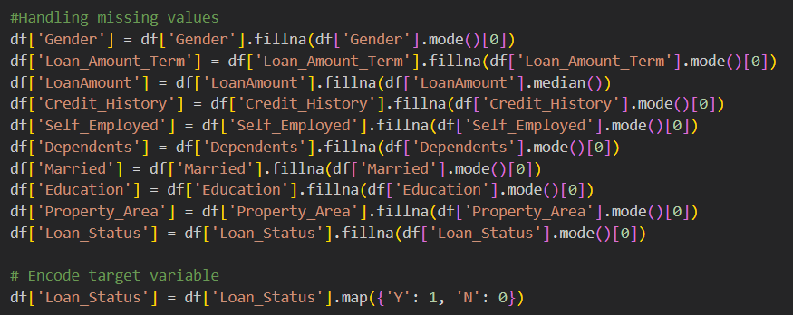
Step 3: Feature Engineering
Handle missing values- For numerical columns fill missing values with the median and for categorical columns fill them with the mode.
Encode target variable (prediction label).

Slide 5
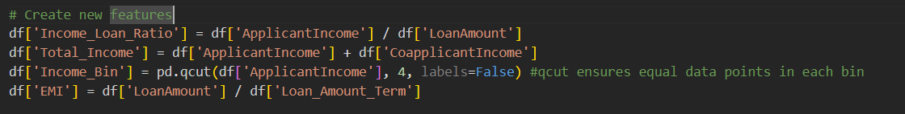
Feature Engineering
Create new features from existing features such as income-loan ratio, total income, income bin and EMI. Income bins are created by dividing the applicants into 4 income brackets.
Used label encoding on the dependents column. Encoding was done based on four categories- 0,1,2 and 3+.
Used one hot encoding on categorical columns such as Gender, Married, Education, Self-Employed and Property area.

Slide 6
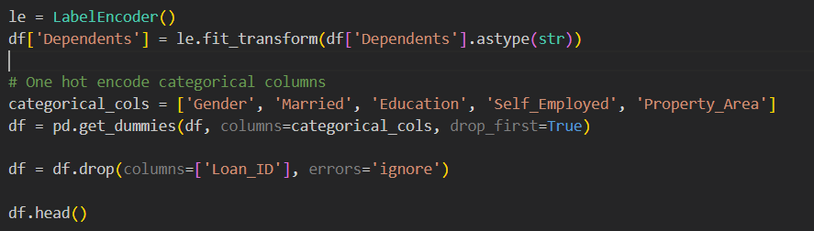
Feature Engineering
For every category, a new binary column is created. First column is dropped to avoid redundancy.
Loan_ID column is dropped since it is of no use in model training.

Slide 7
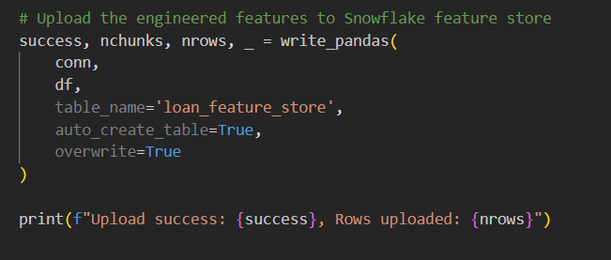
Step 4: Uploading engineered features to Snowflake Feature Store
Select the correct database and schema. Upload all the features by creating a new table.
This automatically creates a table in the selected schema. Overwrite is set to true as it overwrites the table whenever this code is run instead of appending.

Slide 8
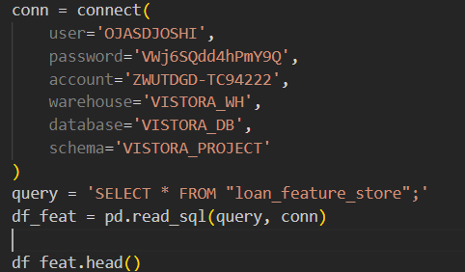
Step 5: Read data from feature store
Engineered features are again extracted from snowflake feature store.

Slide 9
Step 6: Model Training
Set of training features is formed by dropping redundant features and target feature.
Random forest Classifier is used for this classification task.
Model is trained on whole training data.
Cross validation accuracy is found by doing 25-fold cross validation.
79.36% mean accuracy is obtained.

Slide 10
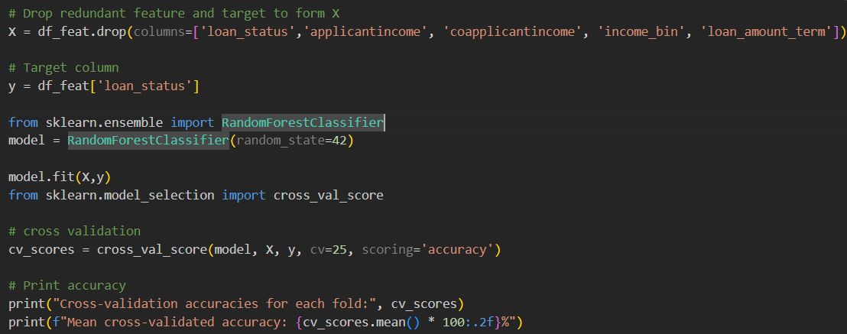
Model Training

Slide 11
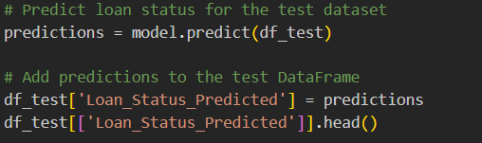
Step 7: Performing predictions on testing data
Perform the same feature engineering on testing data that we did on training data.
Don’t include the target variable this time since it doesn’t exist in testing dataset.
Fit the testing data into the model trained on training data and get the prediction.

Slide 12
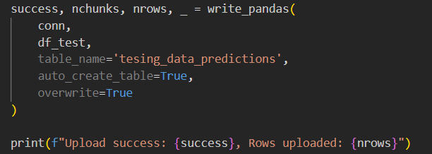
Step 8: upload the predicted values to snowflake
Upload the predicted values to snowflake by creating a new table.

